Slide 1
DHCP
By Thomas Vardy

Slide 2
What is DHCP
DHCP is a protocol used to allocate IPs to devices on a network dynamically as well as network configurations

Slide 3
Why do we need DHCP and what is it used for
To allocate IPs to devices on the network
Devices on the network use it to release there current IP if it is no longer needed
Devices also use it to renew their lease on their IP
Before DHCP system administrators would have to manually set up IPs for the devices on the network and DHCP saves a lot of time by removing this task

Slide 4
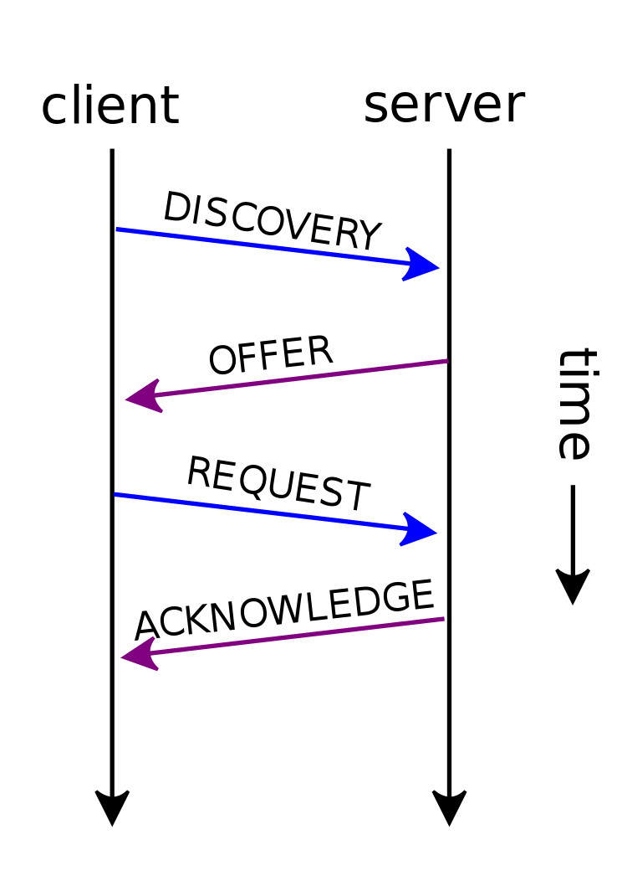
How it works
There are 4 main stages to most DHCP client
server interactions:
Discovery
Offer
Request
Acknowledgement

Slide 5
Discover
The DHCP client sends a discover message so that the DHCP severs can reply and let the client know that it can connect to the sever
The discover message is sent to via a broadcast message so that everything within range can see the message

Slide 6
Offer
The DHCP servers then reply with a DHCP offer, that includes all the settings for the router and contains the IP that is being offered to the DHCP client and also contains the server's IP address
This message is sent directly to the DHCP client looking for a network to connect to
This message will be sent from every available DHCP server to the client
Before the server sends the offer it sends a ICMP ping to the IP address that it is going to offer to make sure that the IP is available

Slide 7
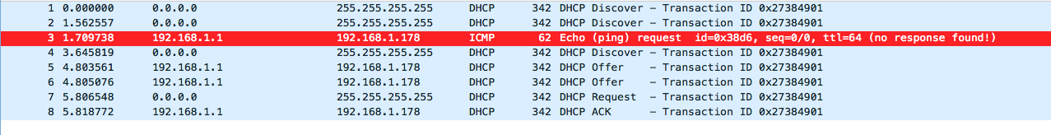
ICMP packet

Slide 8
Request
The DHCP client then replies to the offer with a request that will include whatever specifications the device needs
This message is broadcasted and it contains the DHCP server identification so that the other DHCP servers can see the message and take from it that the client has refused that server

Slide 9
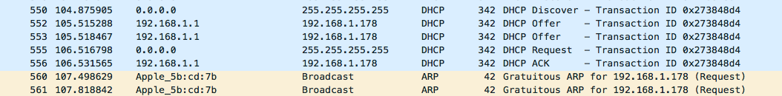
Acknowledgement
The DHCPACK is the message from the DHCP server to the DHCP client letting the client know the final configurations for the connection
This type of message is direct to the client from the server
After the server has sent the acknowledgement the client will broadcast a ARP to the network to prevent conflicts

Slide 10
Decline
A decline message is sent to the router form the client if when the ARP message is sent and there is a reply, meaning that another device already has that IP address
If there is no response then the IP is assumed to be available and unused

Slide 11
Release
When a device no longer needs its IP anymore it should send a DHCP release message to the server so the the server can return the IP to the IP pool
However the clients often don’t know when there going to disconnect from the server so the DHCP release isn’t mandatory

Slide 12
IP lease
Leases are normally set for long times but they the times need to be appropriately selected
If the leases are in too long and the router is in a position where it is going to get a lot of different devices connecting to it then the router could potentially run out of IPs to give to the new devices
If they are too short then the lease renewing could interrupt the users when they are trying to access the internet

Slide 13
Inform
This is a message from the client to the server to request more information from the sever than what was sent from the server in the initial offer message

Slide 14
Negative acknowledge
A DHCPNAK is sent to the client when the IP address its using is being used by another device
This means that the client receiving the message must start the whole connection process again

